Slide 1

Musify-Music Composition using AI
Seasons of Code

Slide 2
Automatic Music Generation is a process where a system composes short pieces of music using different parameters like pitch interval, notes, chords, tempo, etc.
In this Project we used Piano Instrument with the following terms:
Note: This is a sound produced by a single key.
Chords: The combination of 2 or more notes is called a chord.
Octave: The distance between two notes is stated as an octave in a piano. It is specifically the gap between the two notes that share the same letter name.

Slide 3
About Project:
The Project based on creating an Automatic Music Generation model using LSTM.
We fetched the notes from all music files which then fed into the model for prediction. Then finally we created a MIDI file using these predicted notes.
We used Long Short Term Memory (LSTM) , a type of Recurrent Neural Network (RNN)
The Libraries which are used in automatic music generation project are as follows:
1.Tensorflow 4. NumPy
2.Music21 5. Sklearn
3. Keras 6. tqdm
Music21 is a python library that is used to parse and read various musical files.

Slide 4
Project Structure:
All Midi Files/: This is the dataset folder containing various midi files of different composers.
code.ipynb : In this file, we will build, train and test our model
MOD : This directory contains optimizer, metrics, and weights of our trained model
pred_music.mid: This is a music file of predicted notes.

Slide 5
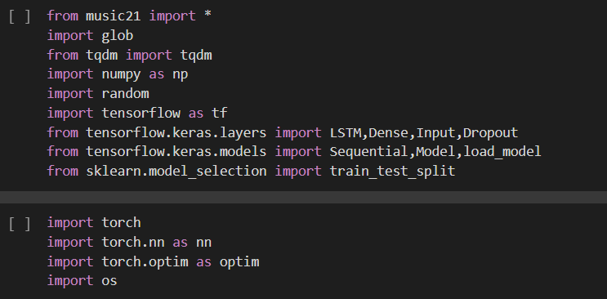
Import Libraries

Slide 6
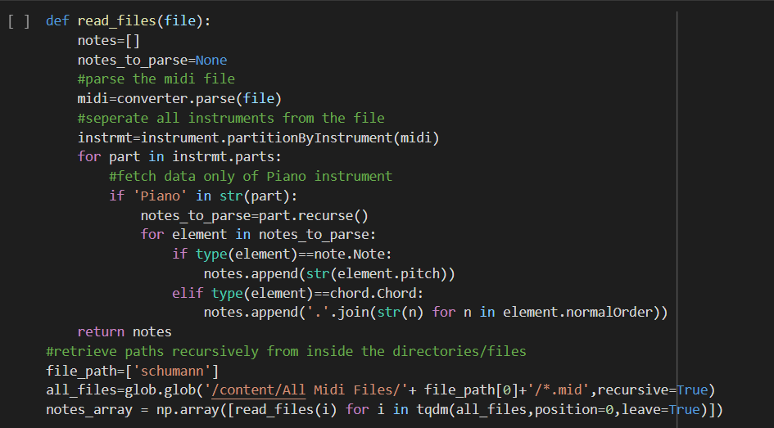
Reading and Parsing the Midi File

Slide 7
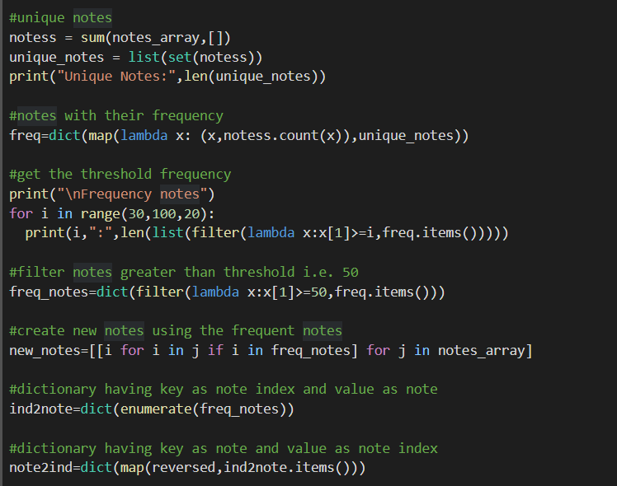
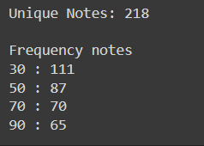
Exploring the dataset
Code:
Output:

Slide 8
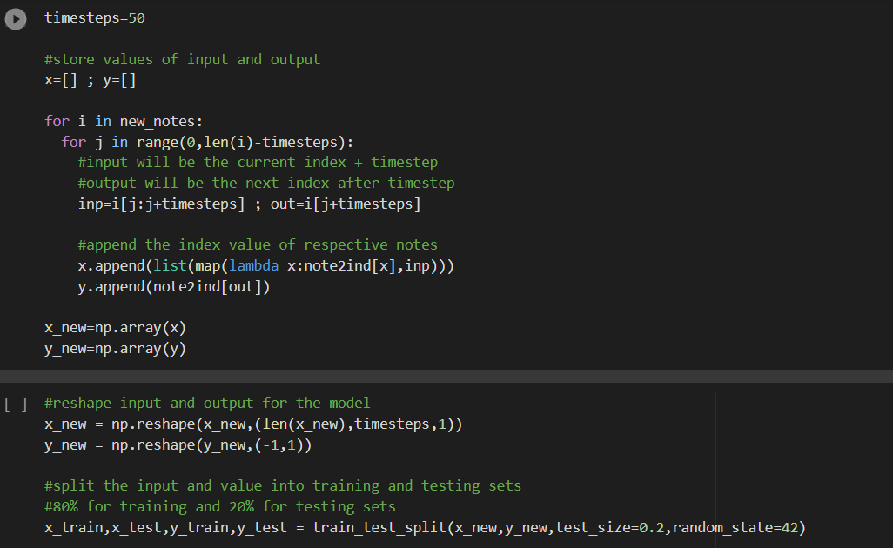
Input and Output Sequence for model

Slide 9
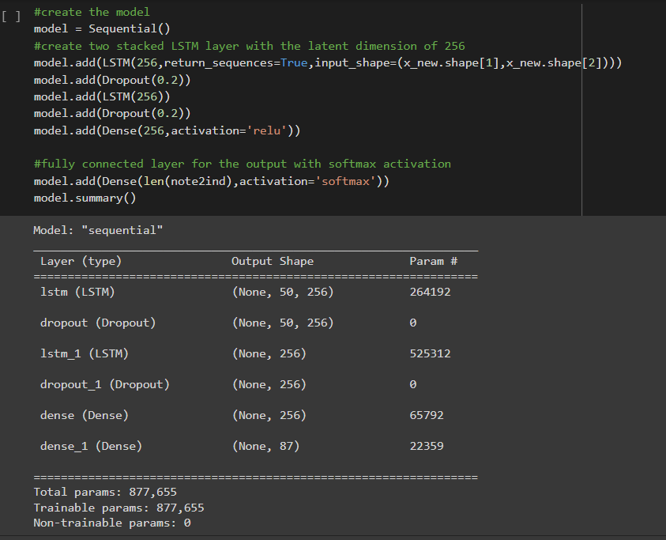
Building the model:

Slide 10
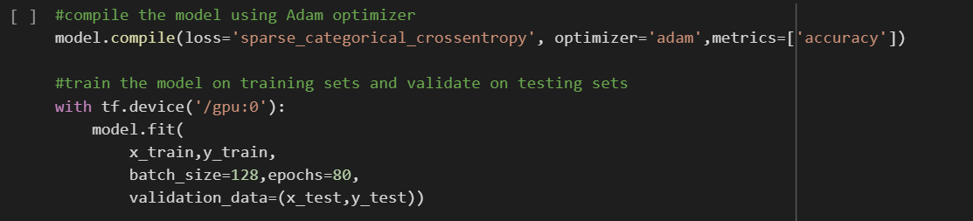

Train the Model
After we finish training let’s save the model for prediction

Slide 11
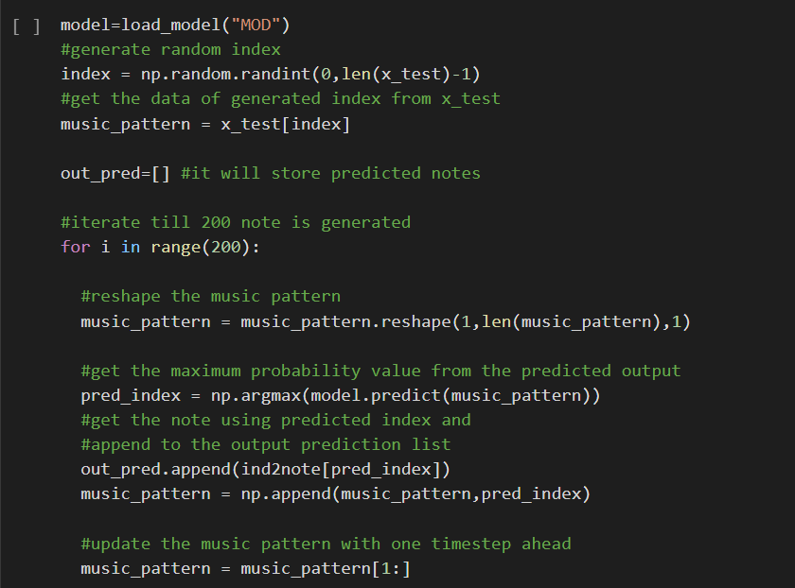
Inference (sampling) phase

Slide 12
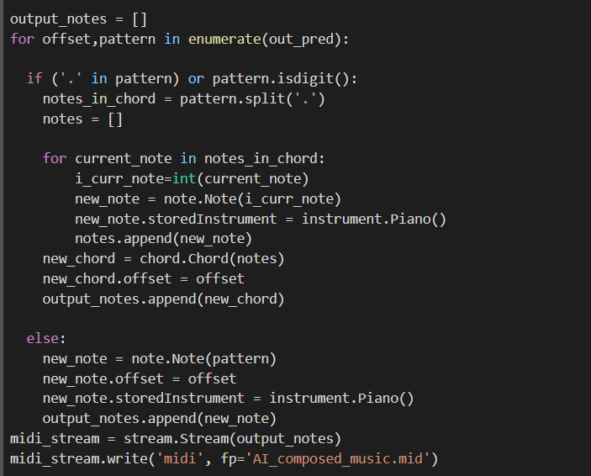
Saving the file

Slide 13

Composed Music

